Slide 1


Bashkortostan Bussiness Trip
Çerkezköy Chamber of commerce and ındustry
Internatıonal relatıons department
İLKNUR İNAL ER
Çerkezköy, Tekirdağ – 2020

Slide 2

SCOPE
1
  Visit of Bashkortostan Chamber of Commerce and Industry
2
  Cooperation Agreement Signing Ceremony
3
  Bilateral Business Negotiations
4
  Forum of Legprom 2020
5
  Meeting with the President of Bashkortostan
6
  Thanks

Slide 3
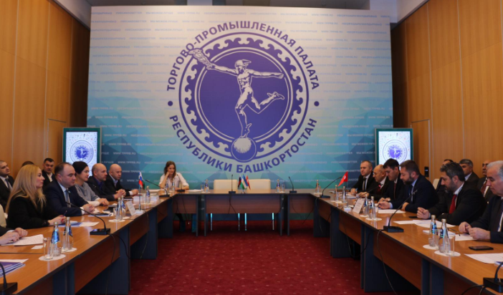
BASHKORTOSTAN REPUBLIC BUSINESS TRIP
Visit of Bashkortostan Chamber of Commerce and Industry
Çerkezköy CCI and Bashkortostan CCI Delegation came together at a meetig held in Baskortostan CCI. During the meeting, the promotional films of the two chambers were watched and the opportunities they would provide for their members in cooperation were discussed.

Slide 4
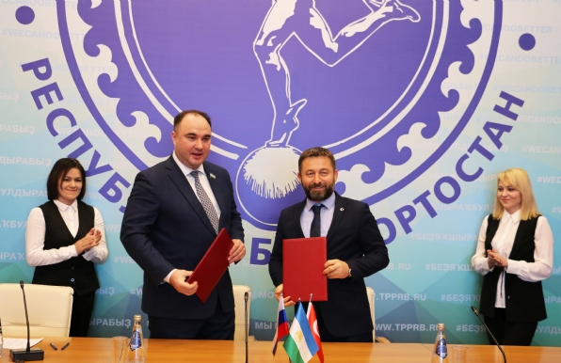
BASHKORTOSTAN REPUBLIC BUSINESS TRIP
Cooperation Agreement
A cooperation agreement has been signed between Çerkezköy CCI and Bashkortostan CCI. This agreement will allow the development of the members of the two Chambers and increase in trade opportunities.

Slide 5
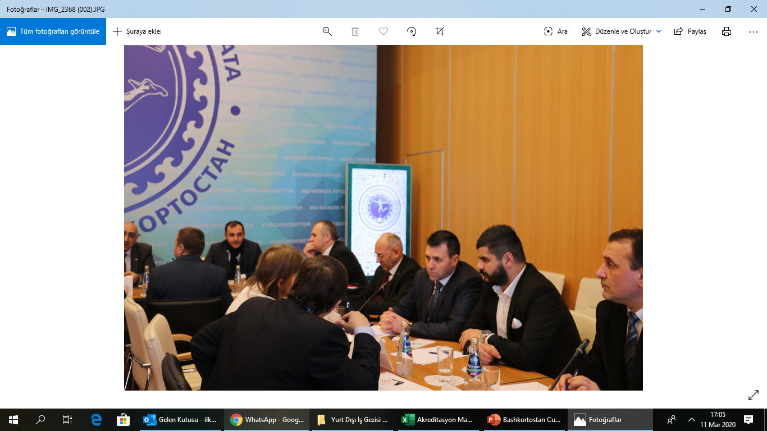
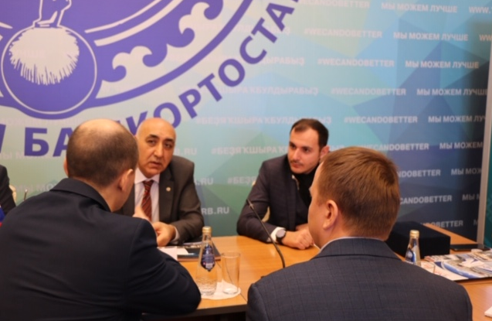
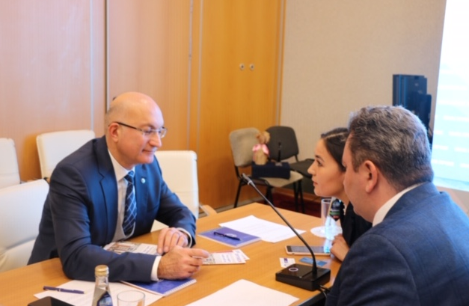
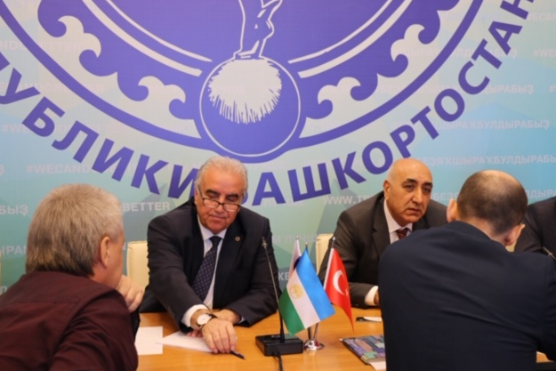
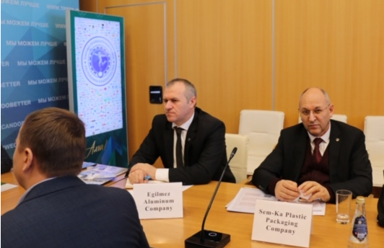
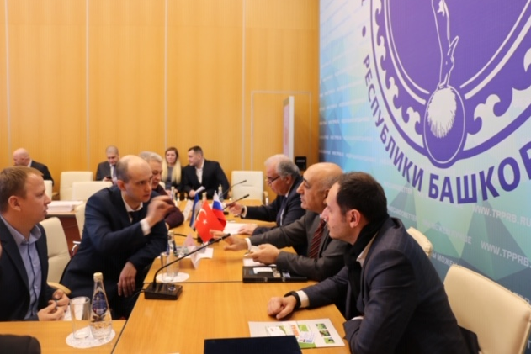
BASHKORTOSTAN REPUBLIC BUSINESS TRIP
Bilateral Business Negotiations
Bilateral business meetings were held between Çerkezköy CCI participating companies and Bashkortostan CCI members. These business negotiations have enabled an increase in mutual trade between the two countries.

Slide 6
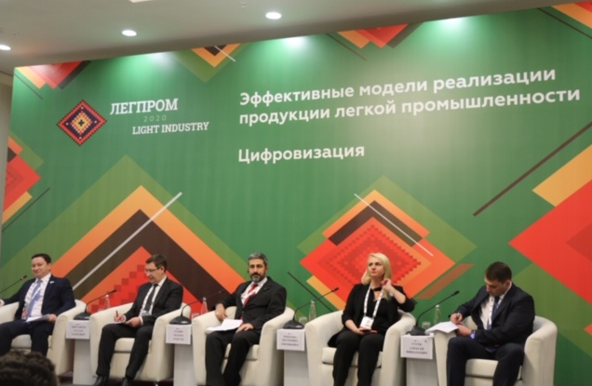
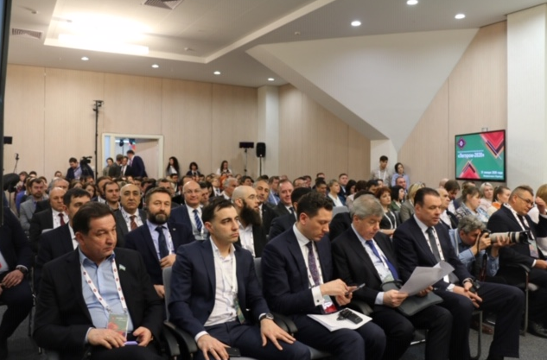
BASHKORTOSTAN REPUBLIC BUSINESS TRIP
Legprom 2020
Çerkezköy CCI members have participated in the development of Light Industry Sectors in the Republic of Bashkortostan. At the forum, our President of the Assembly, Mr. Hacı Mehmet Erdoğan shared the development of the Textile Sector in Çerkezköy Region with the participants and answered the questions of the entrepreneurs in the Republic of Bashkortostan.

Slide 7
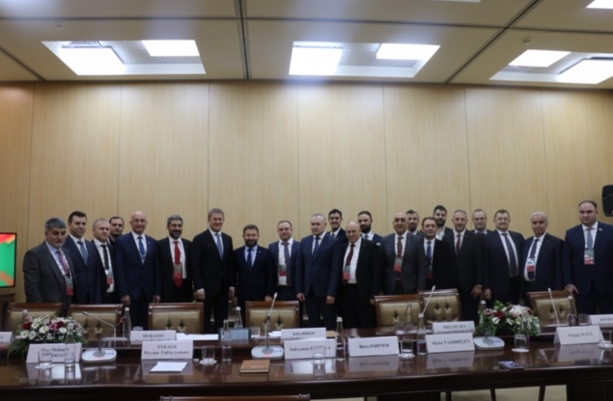
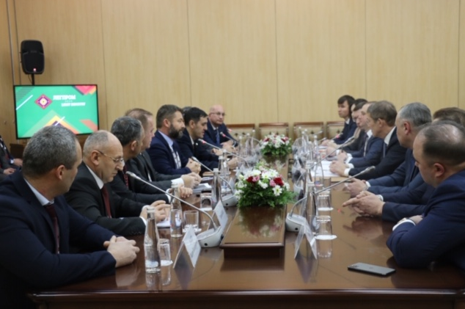
BASHKORTOSTAN REPUBLIC BUSINESS TRIP
to the President.
Meeting with the President of the Republic of Bashkortostan
Çerkezköy CCI delegation held a meeting with the President of Bashkortostan and his deputies. During the meeting, Çerkezköy CCI members conveyed their intention to invest in the region and guiding them in this direction and especially about the visa problem experienced during entry into the country.

Slide 8
THANK YOU
Çerkezköy CHAMBER OF COMMERCE AND INDUSTRY
INTERNATIONAL RELATIONS DEPARTMENT
İLKNUR İNAL ER
Çerkezköy, Tekirdağ – 2020

