Slide 1
SERBIA BUSINESS TRIP
Çerkezköy Chamber of Commerce and ındustry
Internatıonal relatıon and project manager
Veysel dönmez
Çerkezköy, Tekirdağ – 12/06/2022

Slide 2
SCOPE
1
Ambassador’ Visit
2
Economic Forum
3
Biliteral Business Meetings (B2B)
4
Akcity Construction d.o.o Company’s Visit
5
Beteco d.o.o Company’s Visit
6
Cultural Trip
7
Thanks

Slide 3
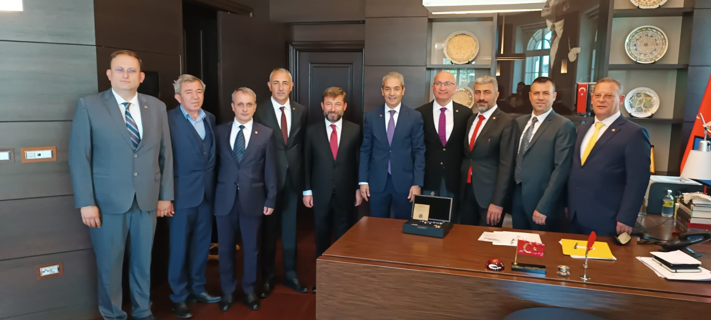
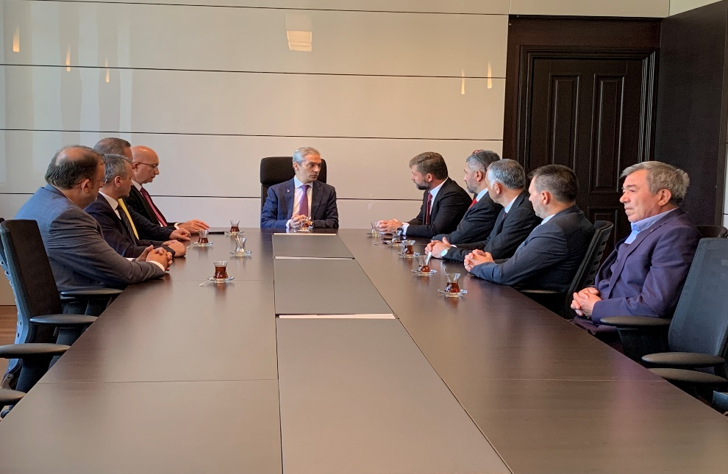
SERBIA BUSINESS TRIP
T.C. Ambassador Of Serbia, Mr. Hami Aksoy’s Visit
The Chairman of the Board of Directors Mr. Süleyman KOZUVA and the Assembly Mr. Hacı Mehmet ERDOĞAN and the Members of the Board of Directors; The Ambassador of Serbia visited Mr. Hami Aksoy in her office and expressed our intention to increase our trade volume with Serbia.

Slide 4
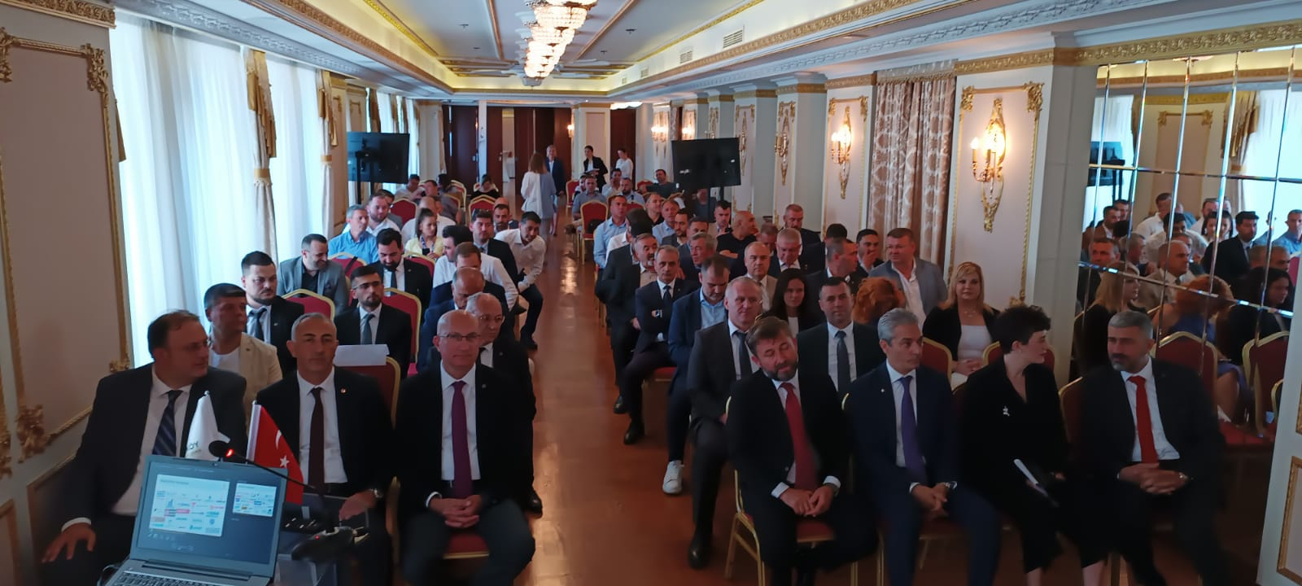
SERBIA BUSINESS TRIP
Economic Forum
With an Economic Forum held in Moskva Hotel Belgrade, Serbian Chamber of Commerce, Belgrade Chamber of Commerce, Kragujevac Chamber of Commerce with its wide industry network, Turkish-Serbian Businessmen Association Presidents, managers, officials and members, Turkish Commercial Counselor Yasemin Yüce and Turkish Ambassador to Belgrade Hami Aksoy and Çerkezköy Chamber of Commerce and Industry members came together.

Slide 5
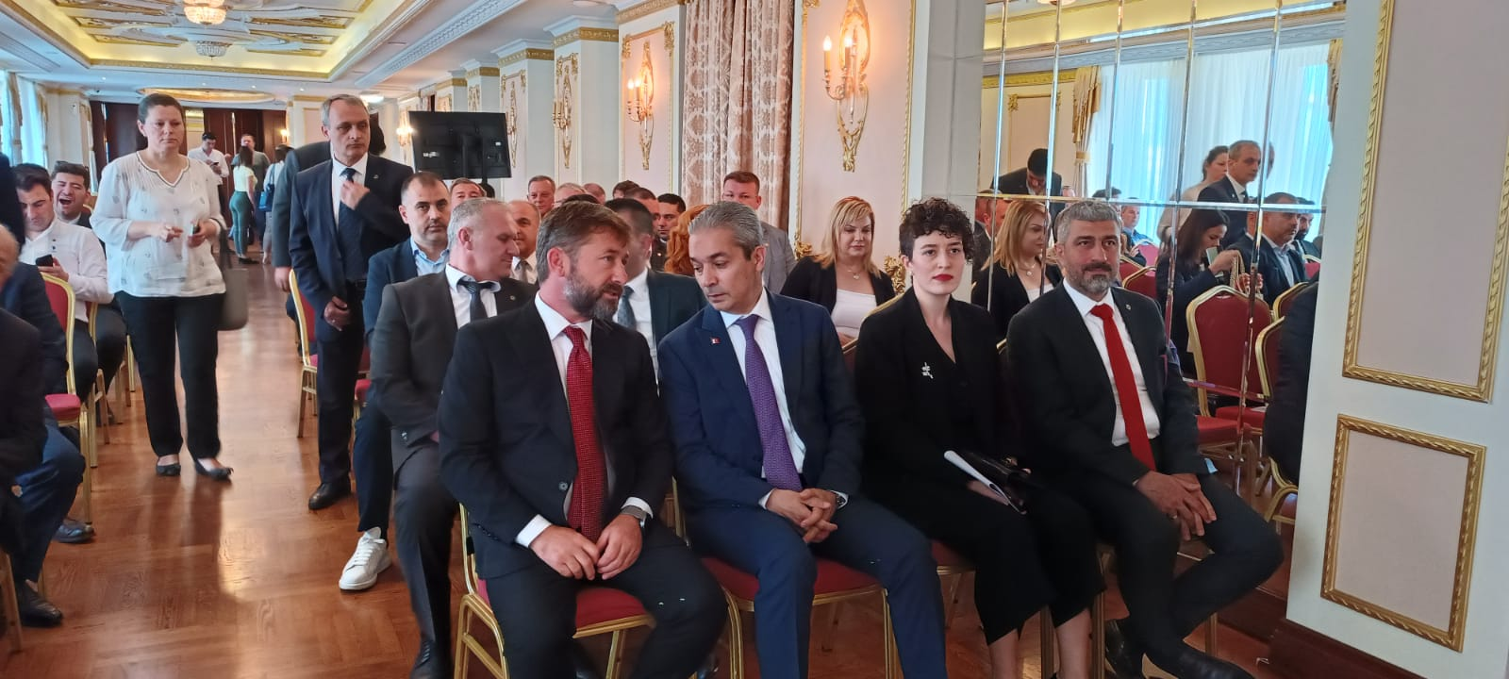
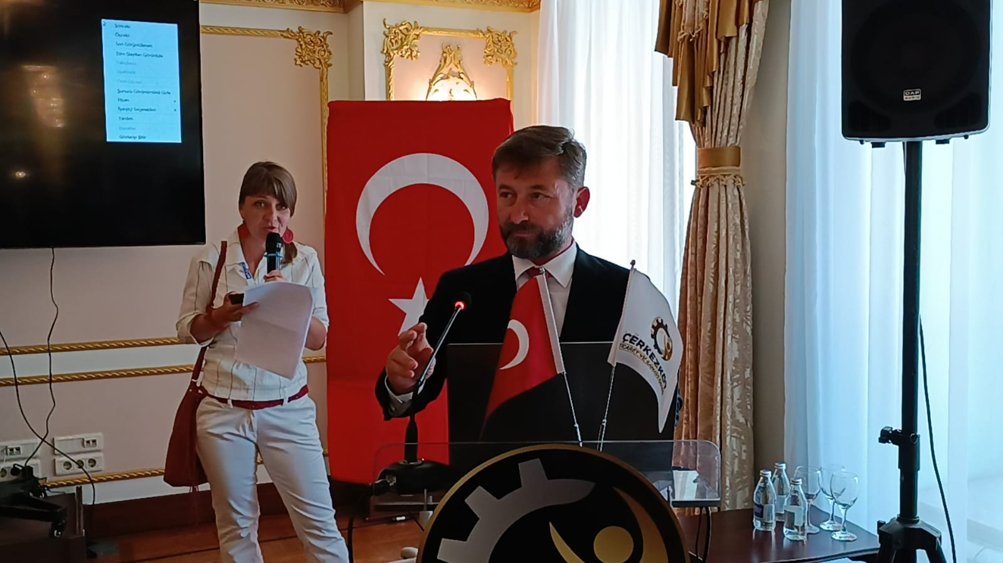
SERBIA BUSINESS TRIP
Economic Forum
With the Economic Forum, Çerkezköy CCI members were informed about investment opportunities, trade and export opportunities in Serbia. At the same time, Çerkezköy CCI members were informed with the Turkey-Serbia Bilateral Trade Presentation held by T.C. Mrs. Commercial Counselor Yasemin Yüce.

Slide 6
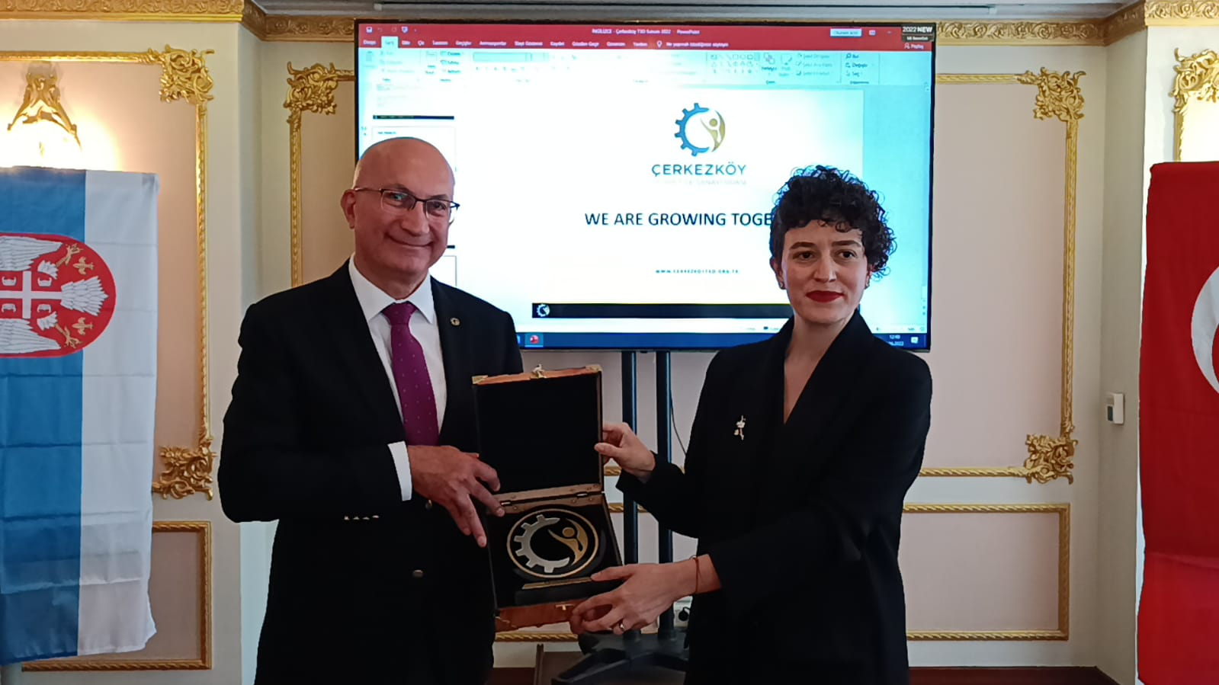
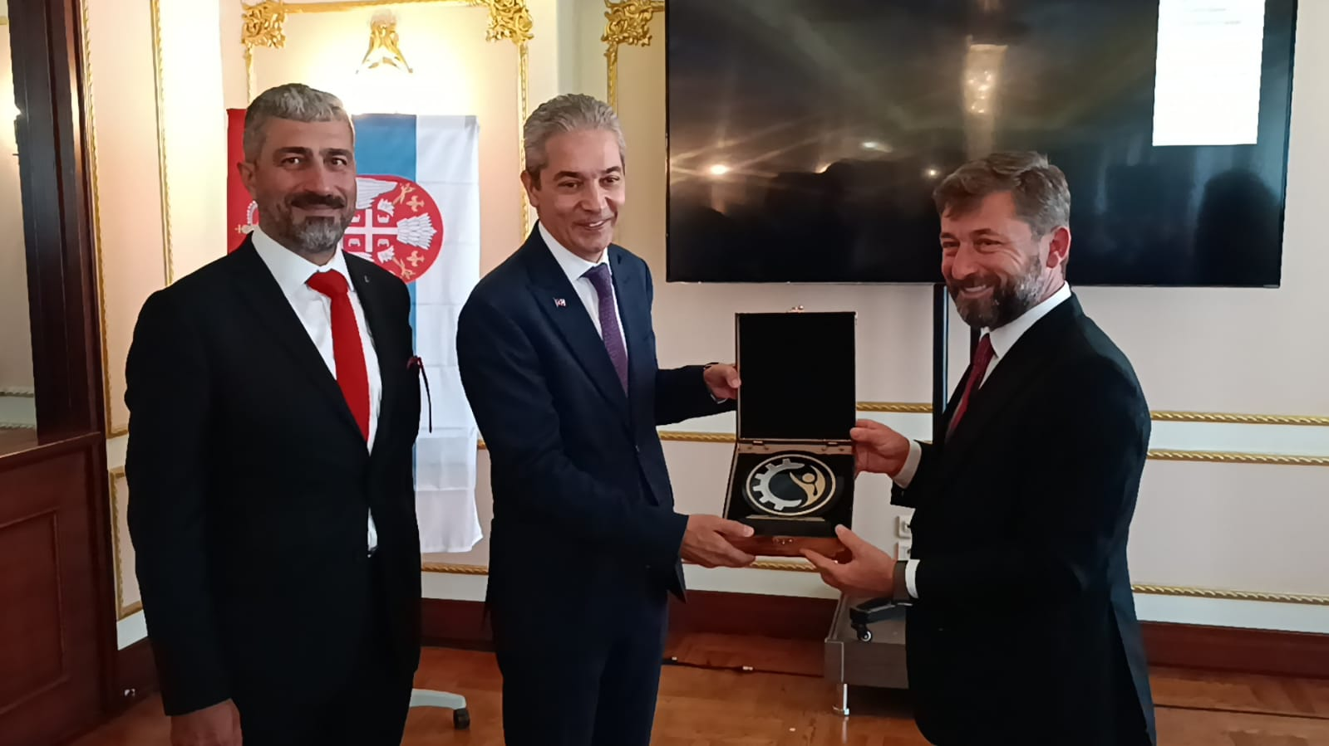
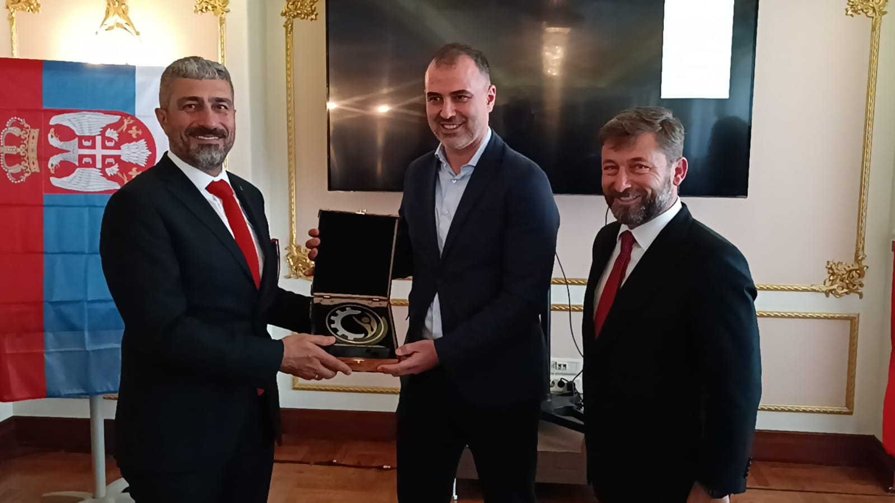
SERBIA BUSINESS TRIP
Economic Forum Gift Presentation
After the Economic Forum, our Çerkezköy CCI President Mr. Süleyman Kozuva, Speaker of the Assembly, Mr. Hacı Mehmet Erdoğan and our Board Member, Mr. Ayhan Arslan presented gifts to our participants.

Slide 7
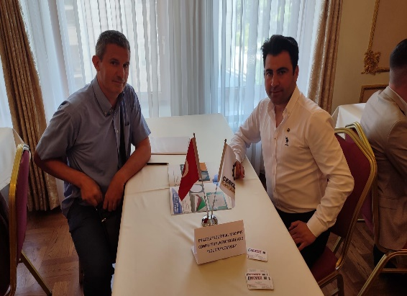
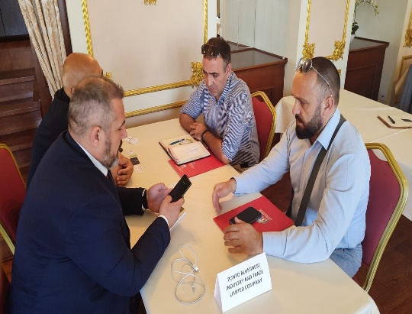
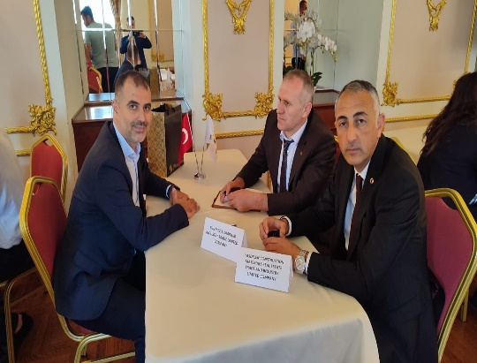
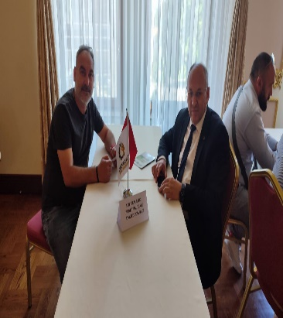
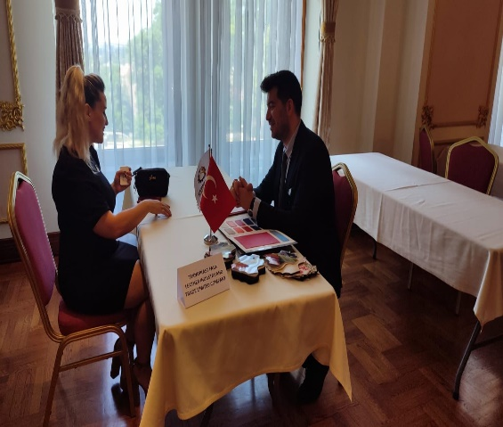
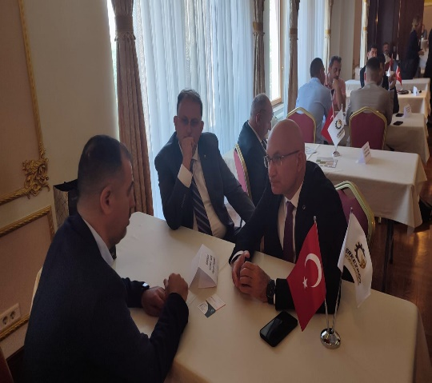
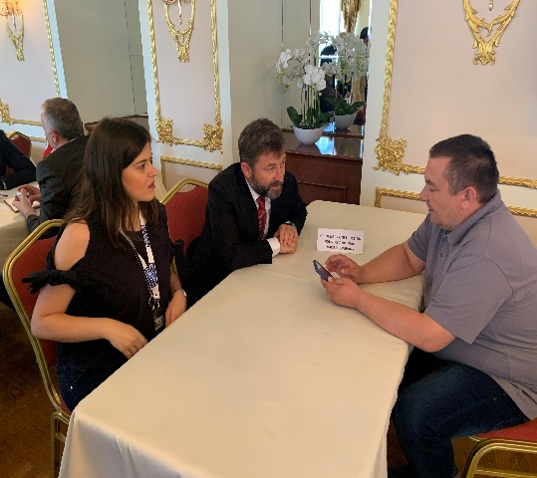
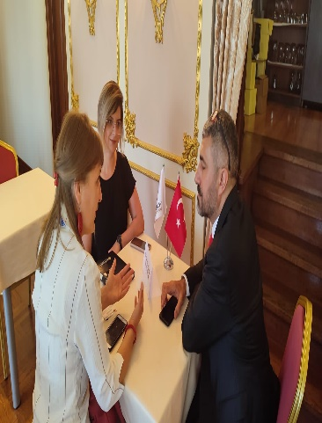
SERBIA BUSINESS TRIP
Bilateral Business Meetings
Çerkezköy CCI member companies came together with Serbian companies within the scope of B2B meetings and made contacts with export and investment issues.

Slide 8
SERBIA BUSINESS TRIP
Bilateral Business Meetings – Business Connections
With our business trip to Serbia, 12 members have established business contacts.

Slide 9
SERBIA BUSINESS TRIP EVALUATION
Event Evaluation
Fair / Business Trip Rating | Satisfied | Enough | Not enough | Average
Your satisfaction with the organization before the event | 33 | 2 | - | 98
Your satisfaction with the contribution of the organization to your company | 32 | 3 | - | 97
Your satisfaction with transportation organization | 34 | 1 | - | 99
Your satisfaction with otel organization | 30 | 4 | 1 | 94
AVERAGE |  |  |  | 97

Slide 10
SERBIA BUSINESS TRIP EVALUATION
B2B Evaluatin
B2B Business Interview Evaluation | Satisfied | Enough | Not enough | Average
Contribution to building a business connection | 23 | 8 | 4 | 85
Contribution to your mutual appointment | 23 | 7 | 5 | 84
Contribution to your agreement for sample exchange | 22 | 8 | 5 | 83
Suitability of the interviewees in terms of quality | 25 | 10 | - | 90
Contribution to planning a mutual visit in the near future | 25 | 9 | 1 | 89
Suitability of space for this event | 31 | 4 | - | 96
Time suitability for this activity | 33 | 2 | - | 98
Would you join us if we planned the same visit? | 34 | 1 | - | 99
Would you attend if the event was held again? | 34 | 1 | - | 99
AVERAGE |  |  |  | 91

Slide 11
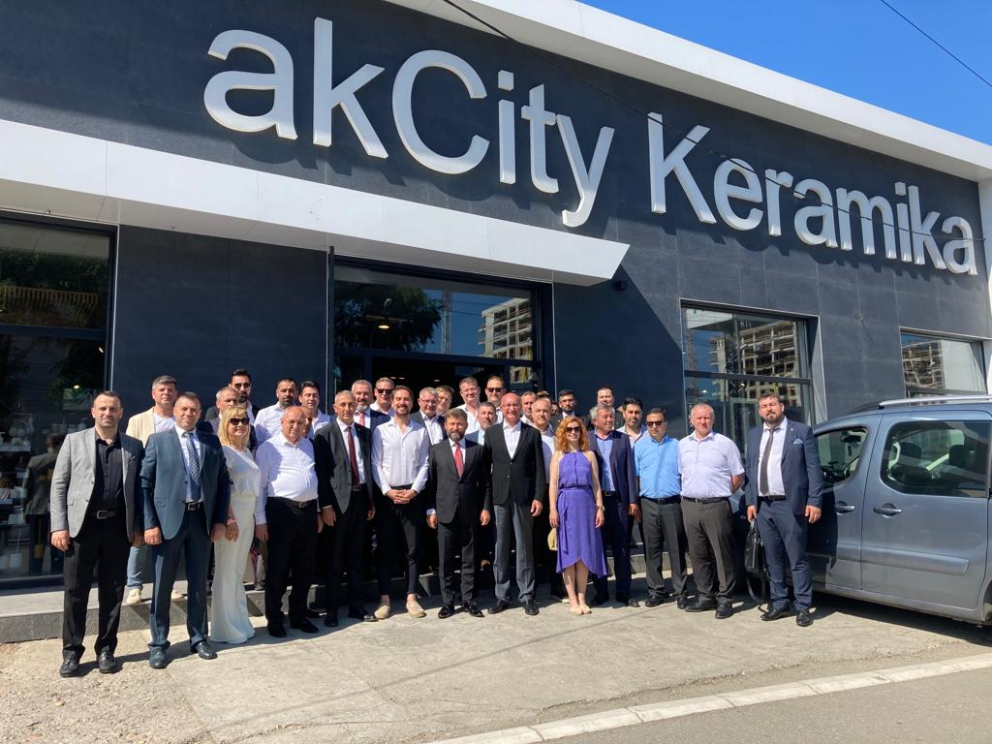
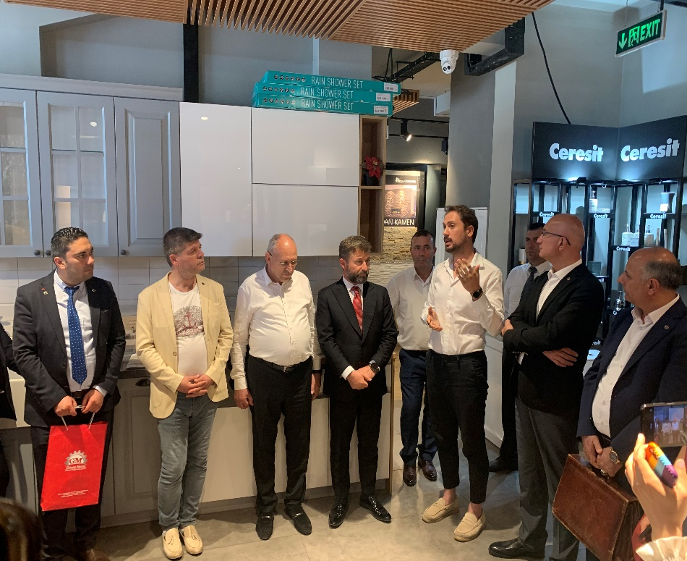
SERBIA BUSINESS TRIP
Akcity Construction d.o.o Company’s Visit
Akcity Construction Company D.o.o., one of the valuable construction and trade companies of Belgrade, was visited by Çerkezköy CCI Members. During the company visit, information was exchanged with Çerkezköy CCI members about the trade operation and trade opportunities in Serbia.

Slide 12
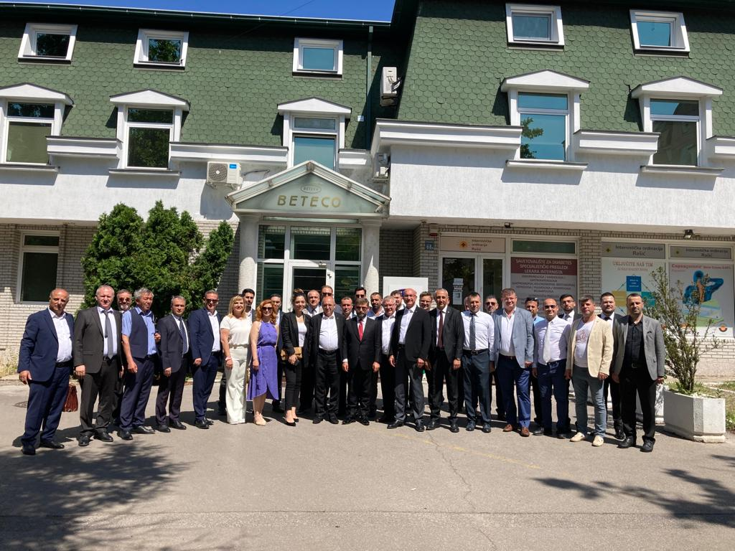
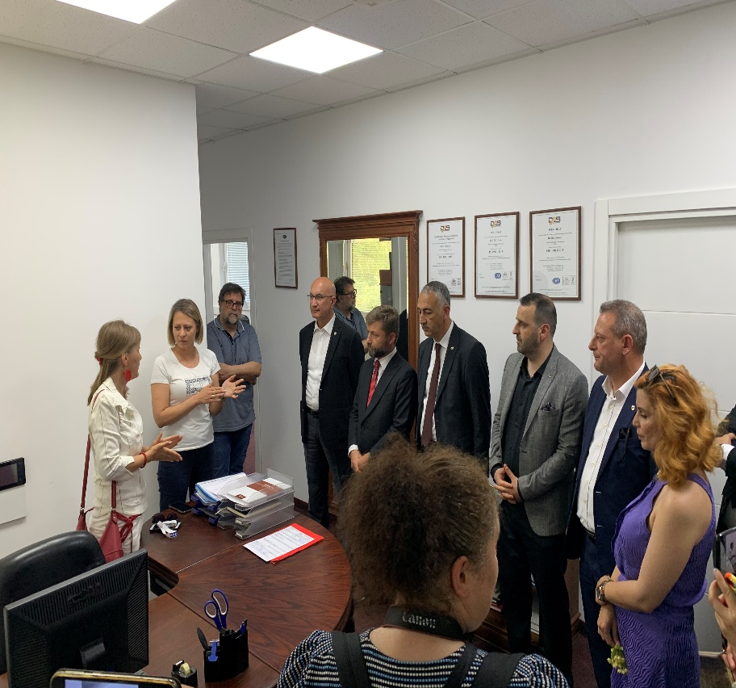
SERBIA BUSINESS TRIP
Beteco d.o.o Company’s Visit
Beteco D.o.o Company is a textile production company operating in Belgrade. During the Beteco D.o.o company visit, on-site observations were made on the production process and activities, and information was exchanged on trade opportunities.

Slide 13
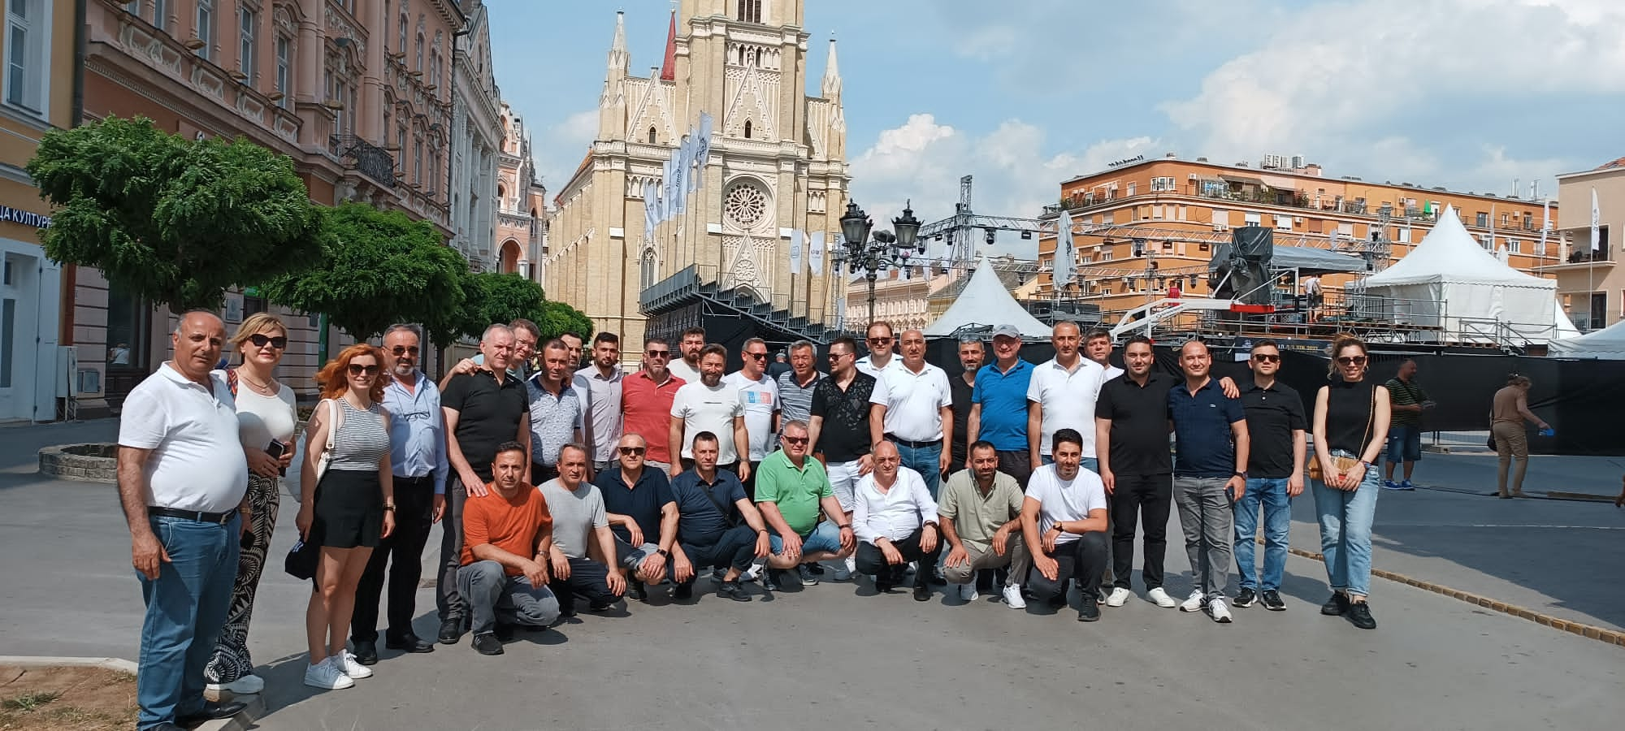
SERBIA BUSINESS TRIP
Cultural Trip
After the Meeting and Business Meetings, a cultural tour was organized with Çerkezköy CCI members to Karlowca and Novisad regions. Information about the historical and cultural heritage of the regions was given by our guide.

Slide 14
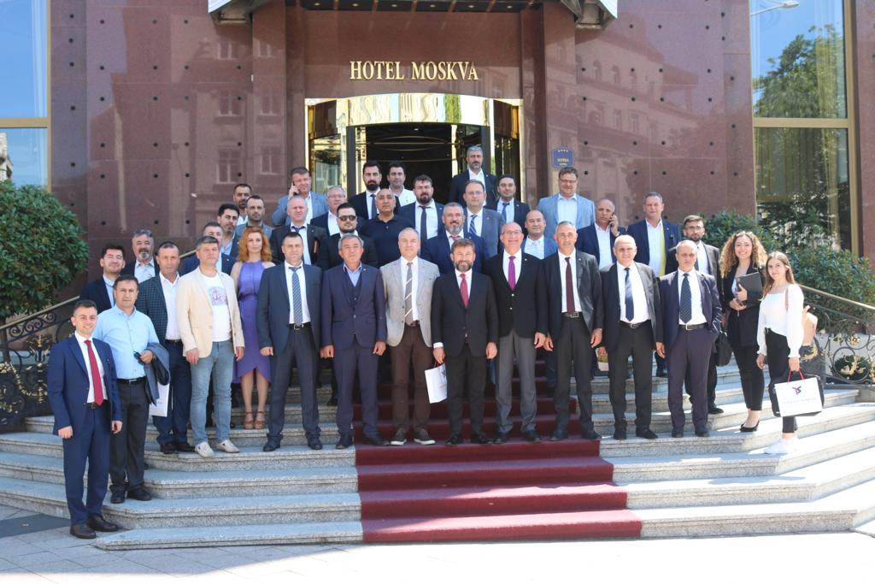
SERBIA BUSINESS TRIP
Çerkezköy CCI Serbia Business Delegation

Slide 15
THANKS YOU
Çerkezköy CHAMBER OF COMMERCE AND INDUSTRY
INTERNATIONAL RELATION AND PROJECT MANAGER
VEYSEL DÖNMEZ
Çerkezköy, Tekirdağ – JUNE/2022

